Slide 1
Ozone Level Detection
STA 9891
Yandi Chen

Slide 2
Ozone level detection
Number of Instances (N): 1847
Original dataset: 2356
Null values: 689
Number of Attributes (P): 73
Sample size (S): 50
Imbalance: (93% : 7%)
0: normal day = 1719
1: Ozone day = 128
Motivation:
Determine which attributes are more relevant to detect Ozone level
Notes:
This data was collected from 1998 to 2004 at the Houston, Galveston and Brazoria area. One is the eight hour peak set (eighthr.data).
This dataset contains temperature, wind speed, wind direction, humidity level measured at different time throughout the day.
The purpose of this study was to help Texas Commission on Environmental Quality (TCEQ) to build highly accurate ozone level alarm forecasting models for the Houston area, (where these technical difficulties come together in one single problem.)
Forecast skewed biased stochastic ozone days
Key characteristics of this problem that are challenging and interesting include:
the dataset is sparse (72 features, and 2% or 5% positives depending on the criteria of "ozone days"),
2) evolving over time from year to year,
3) limited in collected data size (7 years or around 2500 data entries),
4) contains a large number of irrelevant features,
5) is biased in terms of "sample selection bias", and 6) the true model is stochastic as a function of measurable factors.
https://www.researchgate.net/publication/220764870_Forecasting_Skewed_Biased_Stochastic_Ozone_Days_Analyses_and_Solutions

Slide 3
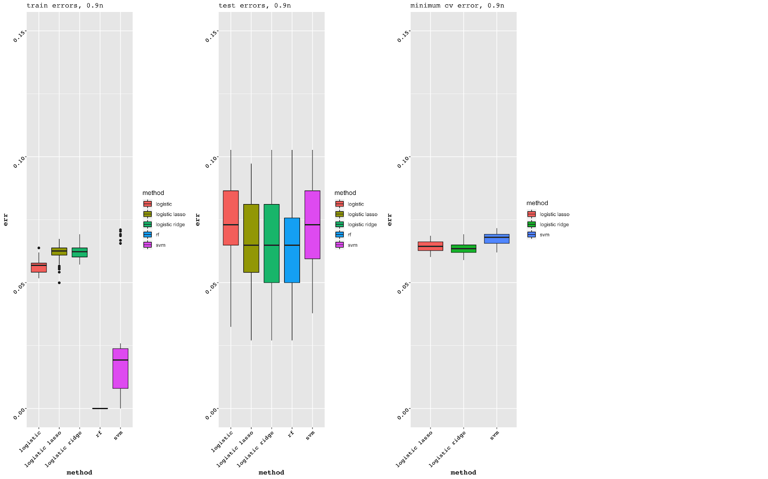
Model comparison:
Train size = 0.5
Train size = 0.9
Notes:
When n = 0.5:
Logistic has the small train error but high test error. This indicate bad at predicting.
RF overfitting, ntree = 300, we can change the number of trees to decrease overfitting.
SVM has large variation in train error
When n=0.9:
SVM has the least train error and a great difference between train set and test set, this might indicate that SVM is not an appropriate model in terms of forecasting.
The results of test error for both 0.5n and 0.9n are similar.
There is no much difference in minimum cv error among lasso, ridge, and svm.

Slide 4
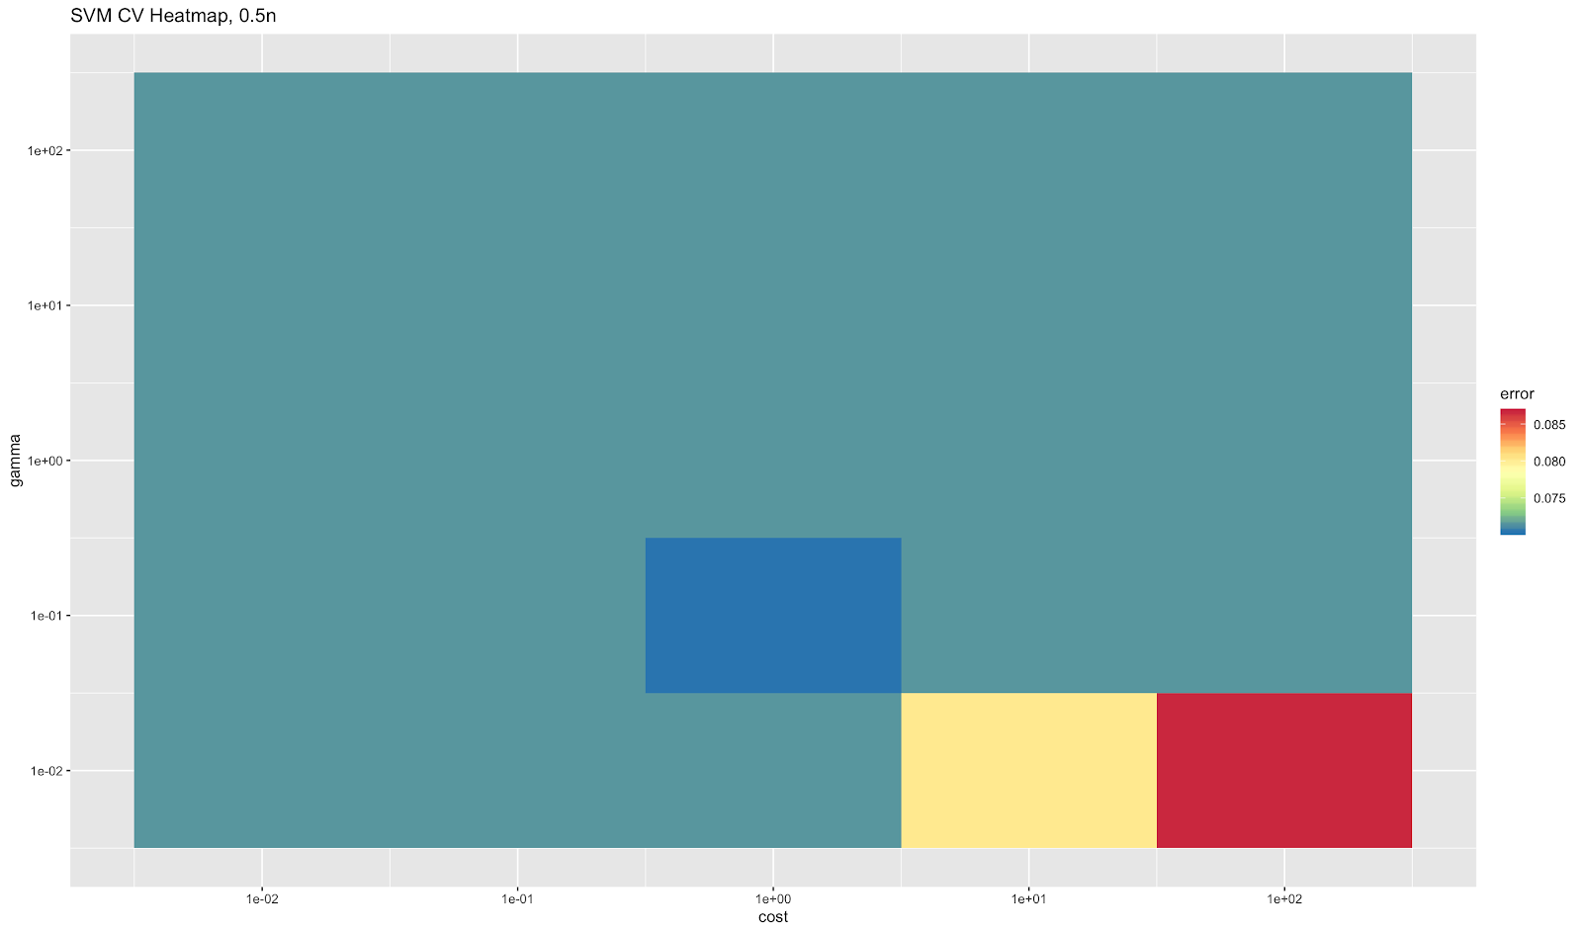
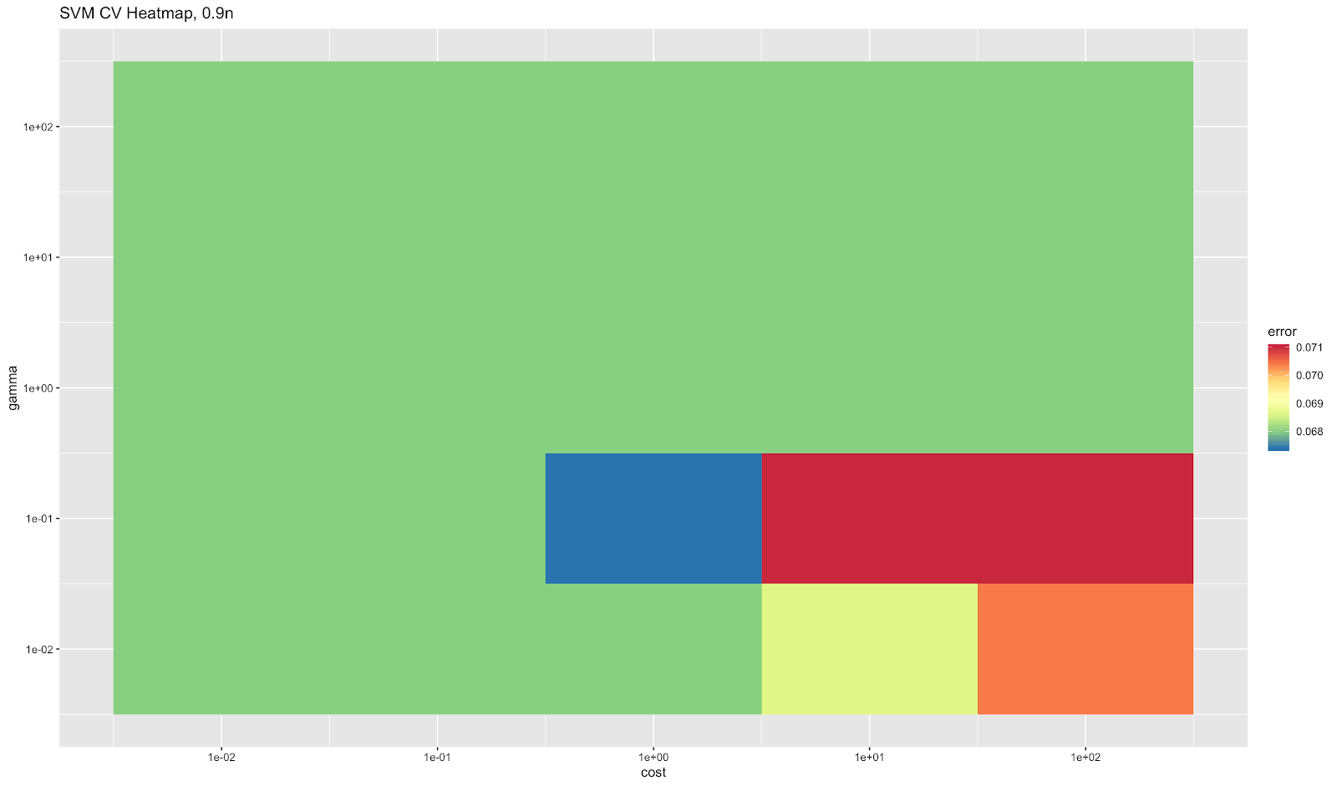
SVM CV Heatmap
Train size = 0.5
Train size = 0.9
Notes:
The error rate for SVM model is really similar for
The results are very similar in both training set. The only difference is when cost increasing, 0.9 training set has slightly more error than 0.5 training set.

Slide 5
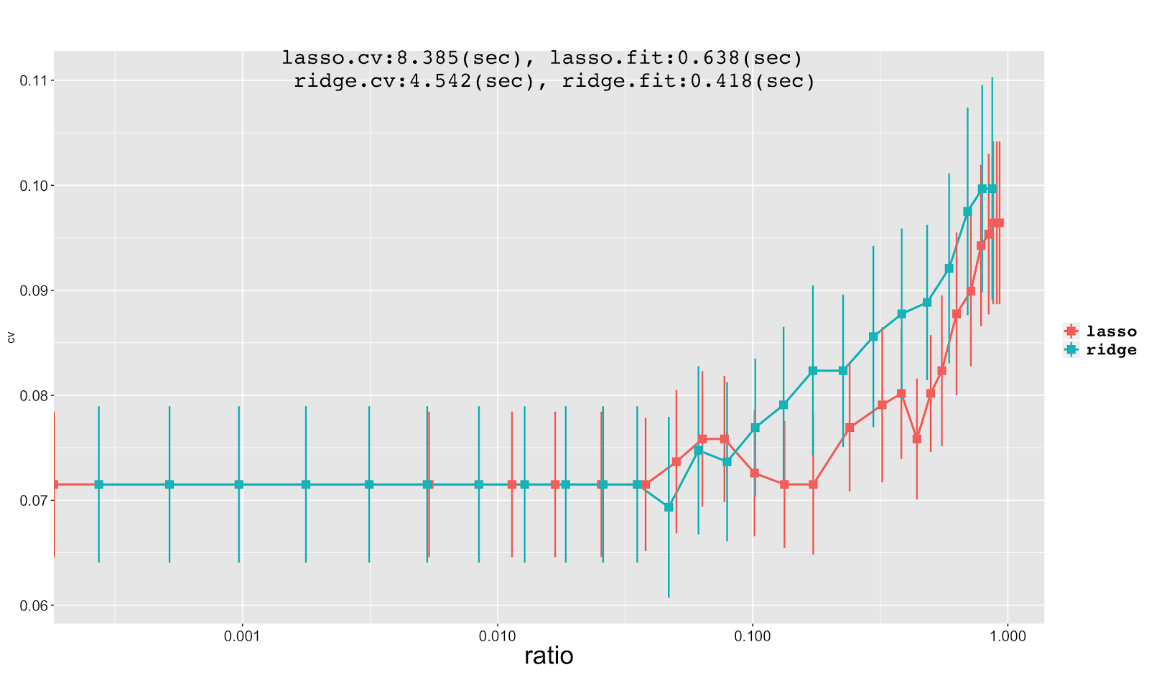
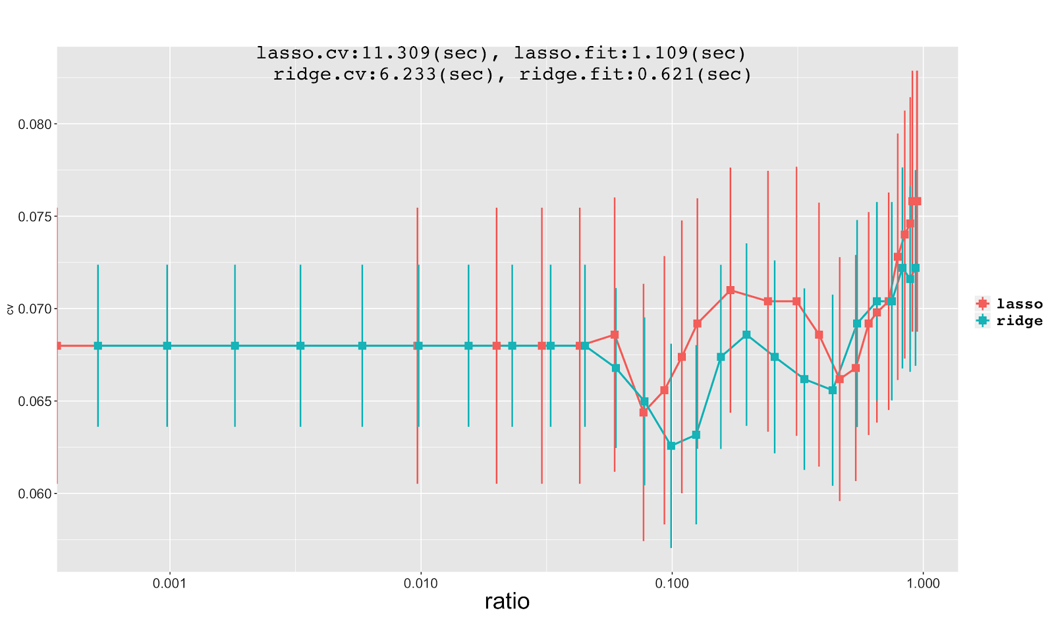
10-fold CV Curves from Lasso and Ridge
m = 25
Train size = 0.5
m = 25
Train size = 0.9
Notes:
10 fold cv rate VS ratio. Ratio = ration between the l2 norm of the models and coefficient estimated against least square coefficient estimated.
Overall, lasso and ridge have similar behavior, but there is slightly difference between these two models.
When train size is 0.5:
As lambda increases, the error rate for ridge tends to increase more than lasso.
When train size is 0.9:
As lambda increases, the error rate for lasso tends to increase more than ridge.
Bias increases, and variance decreases??
Lasso takes more time than ridge, it’s more computational costly.

Slide 6
Model Procedure Time
MODEL | Logistic | Lasso | Ridge | Random Forest | SVM
Time (0.5n) | 0.13334 | 13.27668 | 0.06326 | 0.86644 | 71.74018
Time (0.9n) | 0.18442 | 14.12958 | 3.27736 | 1.749 | 210.5241
Notes:
The time it takes to run different models using different sample size have similar results.
SVM takes the longest time to cross-validate, while logistic regression takes the shortest time.
As we increase the training size, the procedure time for each model also increases.

Slide 7
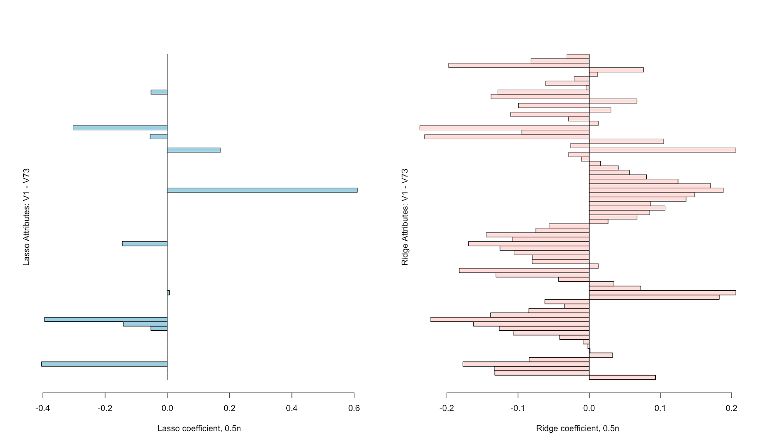
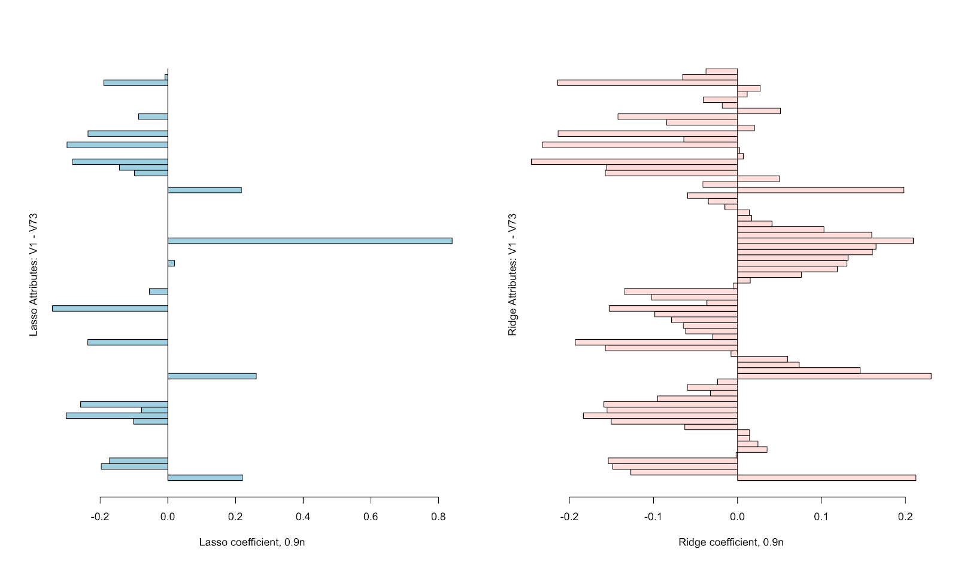
Coefficient Plot
Train size = 0.5
Lasso: V43 > V52 > V20
Ridge: V52 > V20 > V43 > V19
Train size = 0.9
Lasso: V43 > V19 > V52 > V39
Ridge: V19> V43> V52 > V42
V19: WSR17 – wind speed at 17:00pm
V20: WSR18 – wind speed at 18:00pm
V39: T11 – temperature measured at 11:00am
V42: T14 – temperature measured at 14:00pm
V43: T15 – temperature measured at 15:00pm
V52: T_PK – peak temperature
Notes:
The importance of parameters are really similar for Lasso model in these two different training set.
As for ridge, the level of importance for these 73 parameters are a little bit different.
V43, V52, and V19 appeared in both models.

Slide 8
Summary
Performance: Ridge > Lasso > Random Forest > Logistic > SVM
Cost: Logistic < Random Forest < Ridge < Lasso < SVM
Tune the hyper parameters and tree size in Random Forest to avoid overfitting
Notes:
In conclusion, after analyzing the performance and cost for these five models, I would recommend to use ridge to forecast the Ozone level detection. Because it has the best performance and a relatively fast procedure time.
Random forest is overfitting, so we might need to tune the parameters and adjust the tree size to avoid overfitting.

